Slide 1
Azure DevOps CI/CD

Slide 2
Agenda
CICD Overview
CICD Stages
CICD Reusability
Handling multiple Environments

Slide 3
Learning Objectives
Define and Demonstrate what is CI/CD

Slide 4
What is CI/CD
CI
Continuous Integration - Set of practices oriented towards:
CD
Continuous Delivery - Set of practices oriented towards:
Making small but frequent changes
Test Automation
Automation - Automating the process of deployment of the well integrated code into new or existing environments
Code/Infrastructure/Configuration as a code (part of deployment process)
Integrating and packaging code into reusable and releasable packages
Notes:
Set of principals that enables

Slide 5
What is CI/CD
Is CICD the same as DevOps?
CI\CD
DevOps
=
Implementation of the DevOps principles via set of Deployment Pipelines (subset of DevOps)
Broader aspect of the Software development lifecycle

Slide 6
What is CI/CD
CI/CD Pipelines
How is CI/CD implemented: CICD is usually implemented with CI/CD Pipeline (named this way regardless of software used) e.g., DevOps Pipelines, Team City + Octopus Deploy
What is it: CI/CD Pipeline is a set of steps that need to be perform for automated release of the software
What are two main stages: Pipeline is composed of two stages types Build and Release (in some newer implementation this boundary became thinner but there is still separation)

Slide 7
What is CI/CD
Pros
Cons
Self documenting
Require initial configuration
Needs Dev effort for creation and updates
Faster and easier environment promotion
Can get very complex
Holds infrastructure as a code
Ability to setup new environment quickly
Less error prone
Pros vs Cons
Notes:
Best Practices:
Use Variable Groups to inject your variable parameters depending on the environment
Use templates to templatise your environment deployment (they should stay relatively the same – there are so exceptions)

Slide 8
What is CI/CD
CI/CD Other Buzz words
Stages – referred to Build and Release Stages executed on the VM to deploy to target environment
Stage Tasks – simple actions done as a part of Stage (e.g., execute script)
Build Agent – Piece of software installed on the VM that enables VM to become compute for the CICD Pipelines.
Build Agent Service Principal – Service account used for the deployment (software need to be authorized to make deployment)

Slide 9

ACTIVITY !

Slide 10

TRUE OR FALSE

Slide 11
IS CI/CD DEVOPS ?

Slide 12
FALSE

Slide 13
RELEASE COMES BEFORE BUILD STAGE

Slide 14
FALSE

Slide 15
CI/CD Allows you to Automate your Deployments

Slide 16
TRUE

Slide 17
Stages Explained
Implementation of CI/CD
Build Stage (CI)
Release Stage (CD)
Download Build Artefact
Inject Environment variables (to deploy Environment)
Deploy Infrastructure
Deploy Code and Configuration
Build project
Run Unit Tests (if applicable)
Package Artefacts and create trigger Release
Collect files from GIT (Scripts, Code, ARM)
Best Practices:
Keep it environment agnostic
Package code as units of work
Use YAML version of Pipeline in DevOps
Pipeline
Best Practices:
User environment Variables to parametrize the environments
Use YAML templates to reuse the code
Configure gates when required e.g., Prod

Slide 18

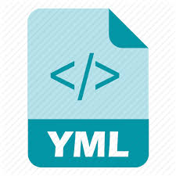

Stages Explained
Pipeline and Repo interaction
Git Repo
PR1
PR2
master/main
Release Stage Dev
(CD)
Release Stage Test
(CD)
Release Stage Prod
(CD)
Build Stage (CI)
trigger
DevOps Pipelines
Notes:
PR Triggers build

Slide 19
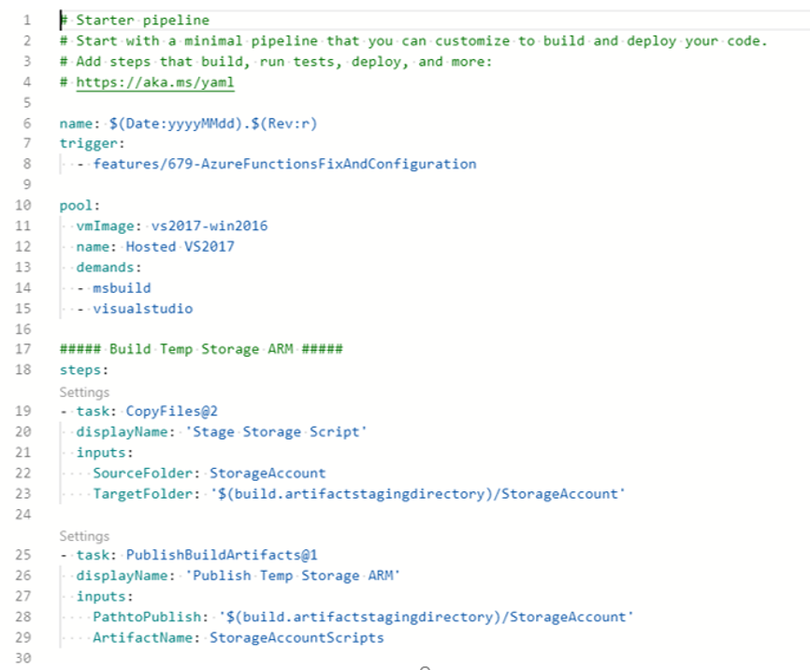

Stages Explained
How do we configure trigger
trigger:
- main
- feature/myFeatureBranch
Remarks: Pipeline will trigger if changes are made on two branches:
main branch
feature/MyFeatureBranch
Best Practices:
Lock your main branch via branch policies so direct commits are not possible
Trigger only on main branch (release if used) – minimize number of branches build triggers from
Tips:
it is possible to trigger of another pipeline
It is possible to bring more than one repository

Slide 20
Stages Explained
CI/CD Creation Process
Configure Azure Tenant
Create Required AAD Objects for all environments (AAD Groups and Service Principals)
Setup Environment Resource Groups/Subscription (RG per environment)
Configure DevOps Project
Setup Service Connection to Azure Tenant from DevOps
Setup Library Variable Group Sets fore each Environment
Create DevOps pipelines (YAML) and save in source control (import pipeline if YAML created outside of DevOps)
Reconfigure Azure Portal
Request Build Agent (IAM) Contributor on the Resource Group/Subscription (Owner required for setting up permissions via script)
Request permissions for Build Agent to Read AAD information
Create Solution
1. Create Project that stores code content (e.g., Database Project, Azure Function Project, AAS Project)
3. Create helper scripts (PS1, BASH etc.) to support deployment
2. Create Infrastructure as code
4. Commit all the code to source control

Slide 21
Agenda
CICD Overview?
CICD Stages
CICD Reusability
Handling multiple Environments

Slide 22



CICD Reusability
Application - Reusable individual YAML components
Main Pipeline.yaml
(calling child pipelines)
Pipelines
Build.yaml (Code Release Steps)
Build Terraform Infrastructure (Init/Plan)
Terraform
Build Service (e.g., Web App)
Visual Studio
uses
Release Environment.yaml (Code Release Steps)
PowerShell Scripts
Release Infrastructure.yaml
(Apply Terraform Plan)
Market Place DevOps Tasks
DeployService.yaml
(e.g., SynapseAnalytics, SQL etc)
Notes:
Deployment steps:
e.g. for Release Infrastructure it can be
deploy ARM/Terraform templates to the environment with this parameters (injected via variable groups)
Run Script to configure security and configuration

Slide 23
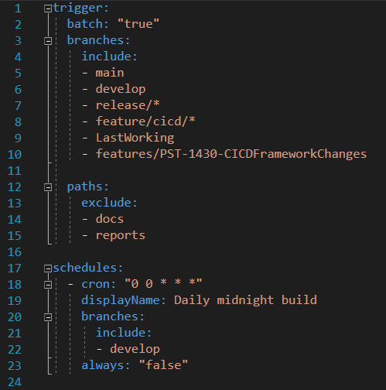
CICD Reusability
YAML – Main Pipeline
Trigger branches
Exclude Repo Paths
Schedules that pipeline should run on
Notes:
Deployment steps:
e.g. for Release Infrastructure it can be
deploy ARM/Terraform templates to the environment with this parameters (injected via variable groups)
Run Script to configure security and configuration

Slide 24
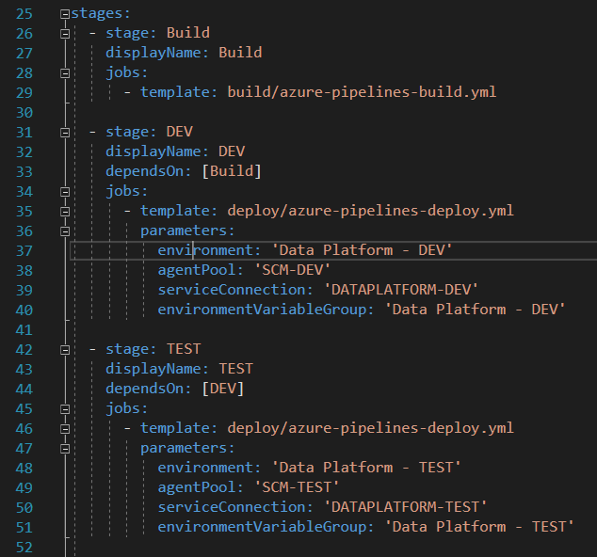
CICD Reusability
YAML – Main Pipeline c.d.
Running Build Stage
Running Deployment (DEV) Stage
Running Deployment (TEST) Stage
Notes:
Deployment steps:
e.g. for Release Infrastructure it can be
deploy ARM/Terraform templates to the environment with this parameters (injected via variable groups)
Run Script to configure security and configuration

Slide 25
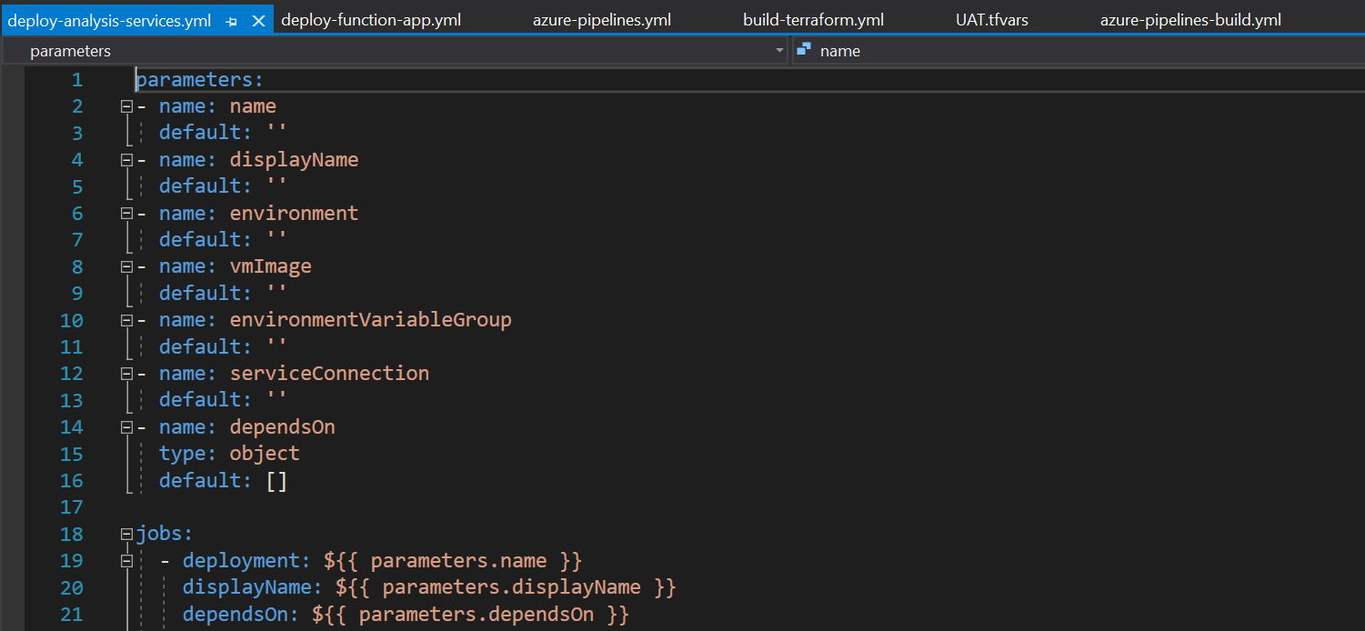
CICD Reusability
YAML – Defining Templates with Parameters
Notes:
Deployment steps:
e.g., for Release Infrastructure it can be
deploy ARM/Terraform templates to the environment with this parameters (injected via variable groups)
Run Script to configure security and configuration

Slide 26
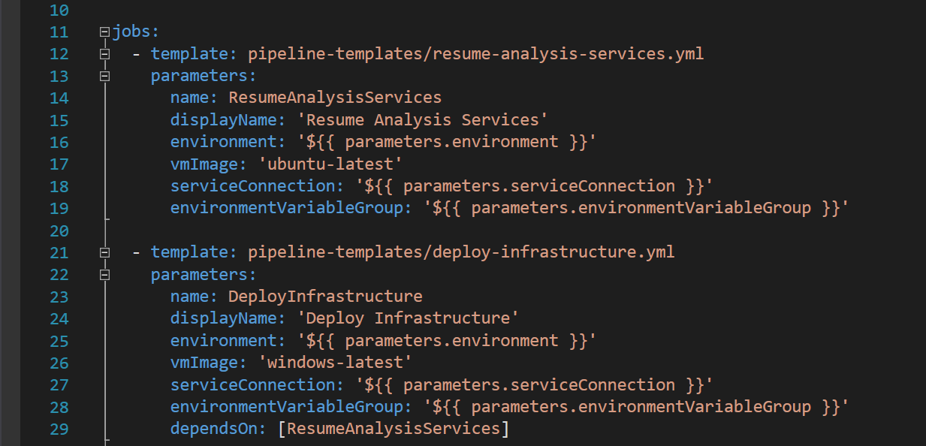
CICD Reusability
YAML – Calling Template with Parameters
Notes:
Deployment steps:
e.g. for Release Infrastructure it can be
deploy ARM/Terraform templates to the environment with this parameters (injected via variable groups)
Run Script to configure security and configuration

Slide 27

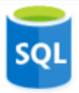




CICD Reusability
Application - Reusable individual components (Terraform)
Application Concept
Main.tf
Azure Key Vault.tf (module)
Azure Databricks.tf (module)
Azure SQL Database.tf (module)
Azure SQL Server.tf (module)
Azure Data Factory.tf (module)
Azure Data Lake.tf (module)
Notes:
Deployment steps:
e.g. for Release Infrastructure it can be
deploy ARM/Terraform templates to the environment with this parameters (injected via variable groups)
Run Script to configure security and configuration

Slide 28
Agenda
CICD Overview?
CICD Stages
CICD Reusability
Handling multiple Environments

Slide 29
Handling multiple environments
Implementation of CI/CD – handling multiple env.
Pipeline YAML/Classic
Build
Release DEV
Release TEST
Release PROD
Inject Parameters
DEV
Inject Parameters
TEST
Inject Parameters
PROD
Artefacts
Code + Scripts
Artefacts
Code + Scripts
Artefacts
Code + Scripts
Artefacts
Code + Scripts
Notes:
Best Practices:
Use Variable Groups to inject your variable parameters depending on the environment
Use templates to templatise your environment deployment (they should stay relatively the same – there are so exceptions)

Slide 30
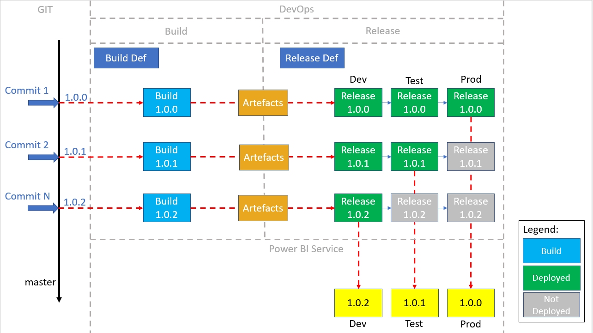
Handling multiple environments
Implementation of CI/CD – Source Control Link
Tips: Build naming convention
$(Date:yyyyMMdd).$(Rev:r)
e.g.
20210301.1
20210301.2
Notes:
Best Practices:
Use good naming convention for your build – e.g., date based so it is clear when the release was made and what revision e.g., $(Date:yyyMMdd).$(Rev:r)

Slide 31
Thank You

Slide 32
Agenda
What is CI/CD?
Stages explained (Build vs Release)
Breaking down an application into reusable individual components
Handling multiple environments
Tips

Slide 33
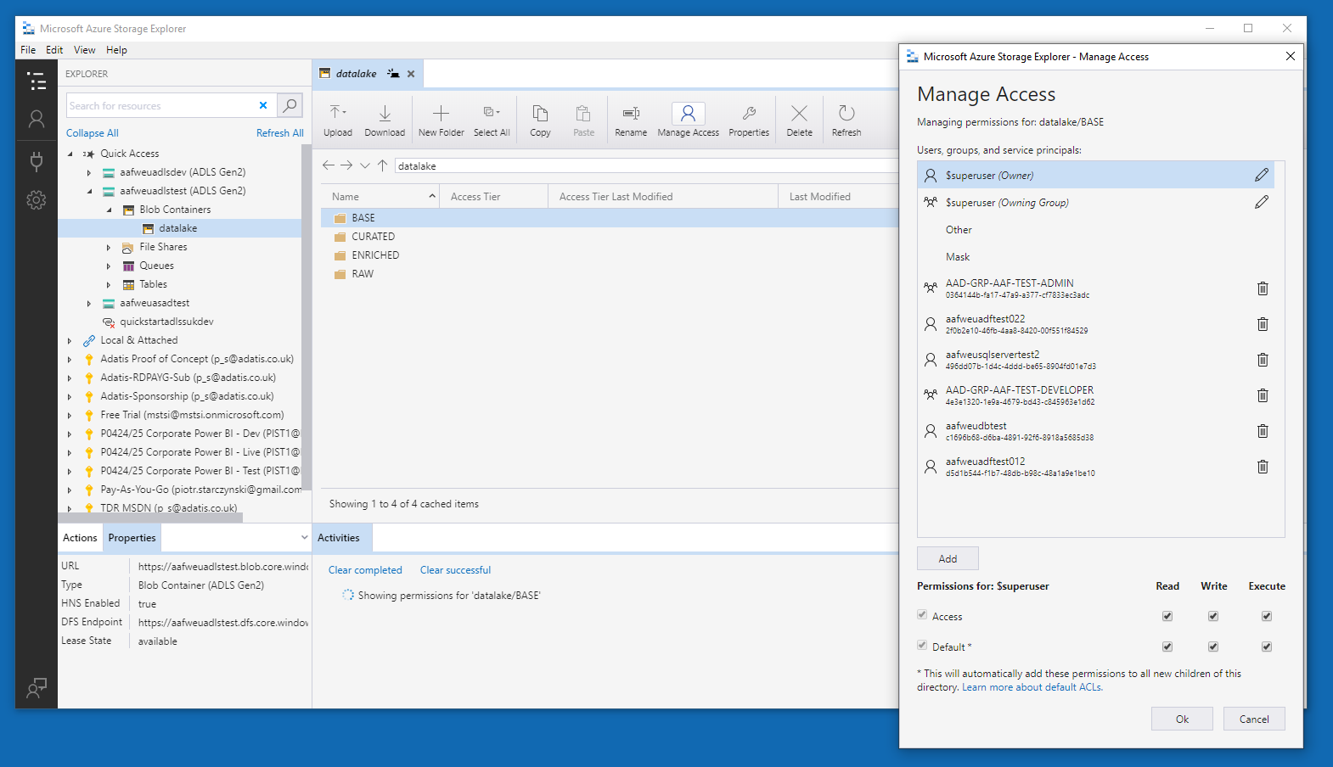
ADLS – What to deploy?
ADLS Service
Folder Structure
Permissions
ADF Ingestion (MSI)
ADF Orchestration (MSI)
SQL Server (MSI)
Databricks (SP)
AAD Groups
Remarks: All configured from DevOps pipelines

Slide 34
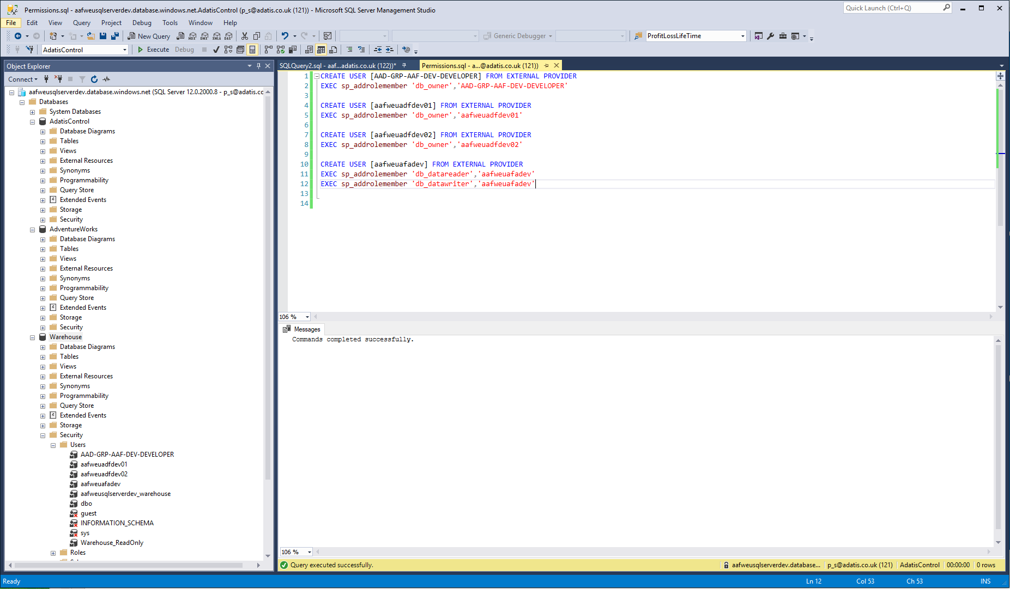
Azure SQL DB – What to deploy?
Resources (SQL Server, Azure DB)
SQL Code and post deploy scripts
Permissions
SQL Admins
AAD Admins
AAD Permissions

Slide 35
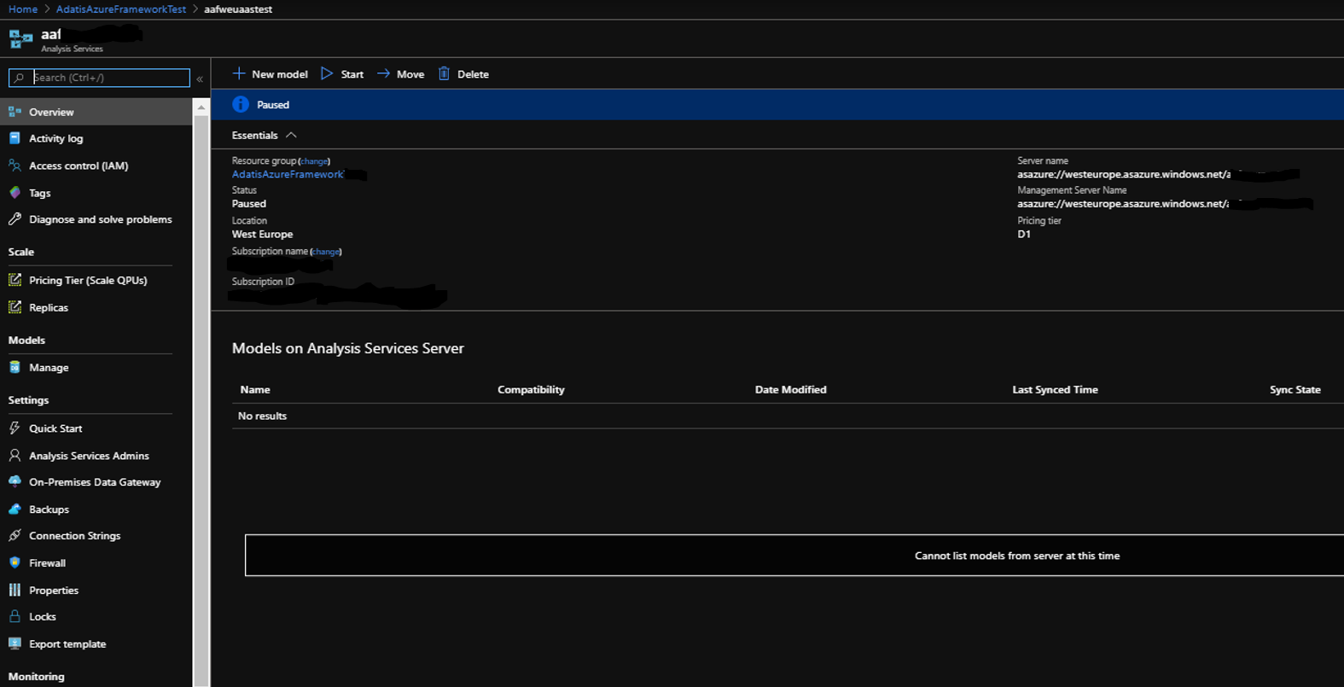

Analysis Services – What to deploy?
Analysis Services Resource
Model (Tabular)
Permissions
SP applied on SQL Server
AAS Administrators
AAD Groups
Build Agent
ADF MSI
Notes:
Semiautomatic – partially deployed automatically. Requires on the first deployment manual token generation. Pipeline will wait for PAT token to be created by release manager (RM). RM need to do KV updated and pipeline variables updated in 2 places (around 5 min work)

Slide 36
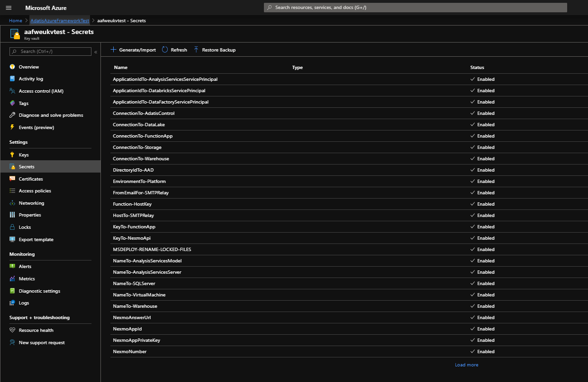
Key Vault – What to deploy?
Key Vault Resource
Secrets
Permissions to view Secrets for
Build Agent
ADF Access
AF Access
Databricks Access
AAD Groups Access

Slide 37
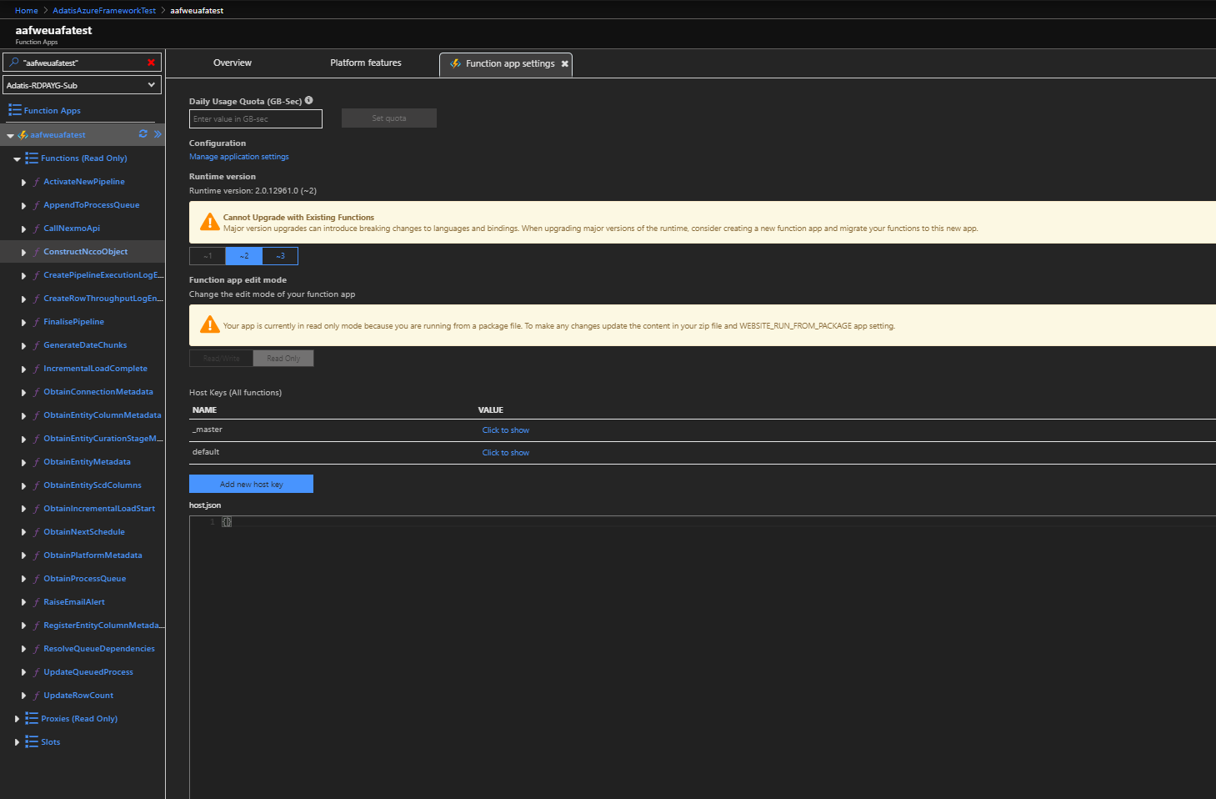
Azure Functions – What to deploy?
Azure Function Resource + App insight + mandatory blob storage
Azure Functions Code
Configuration Settings variables for static values and Key Vault References with the latest key reference

Slide 38
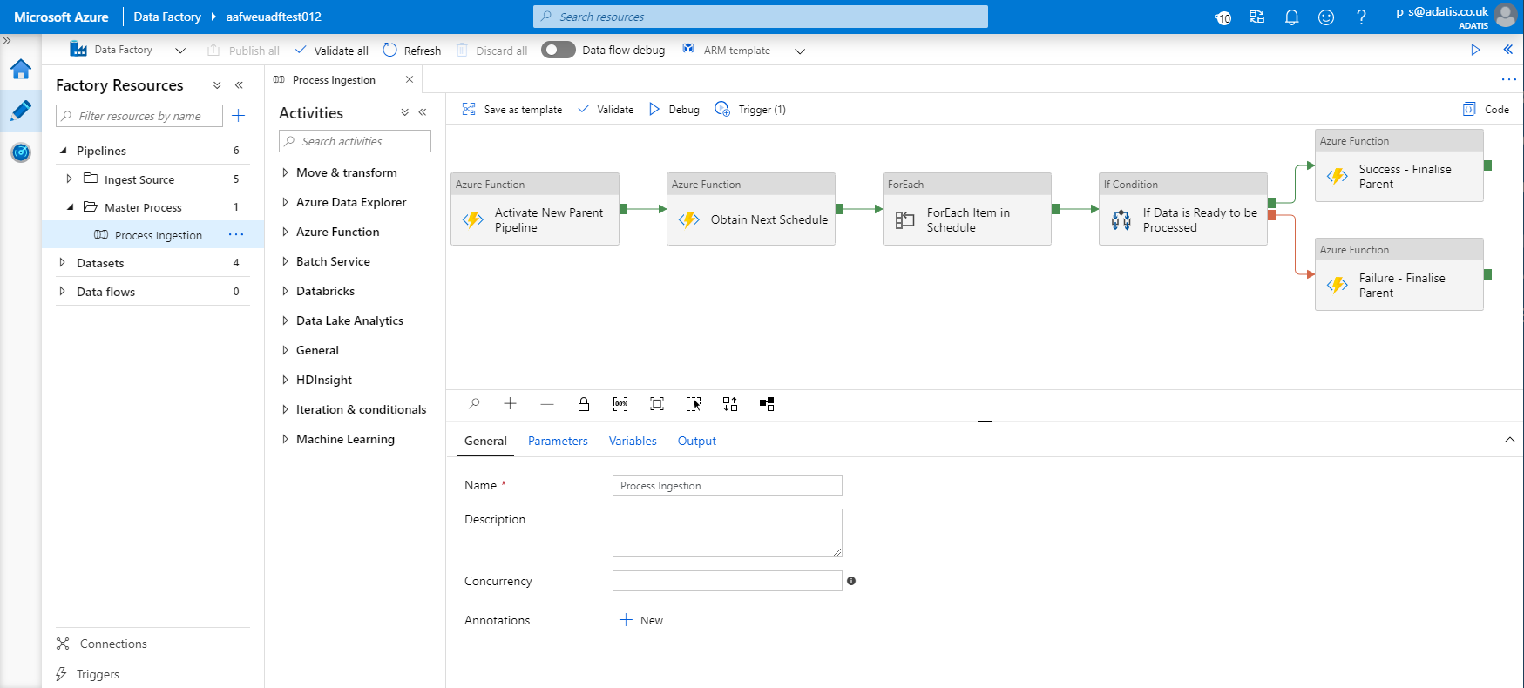
Azure Data Factory – What to deploy?
ADF Resource + Git integration on Dev
Code
Pipelines
Linked Services
Data Sets
Triggers *
Permissions
linked services using MSI whenever possible
Notes:
* Triggers might not work correctly so configuration need to be done after the deployment

Slide 39
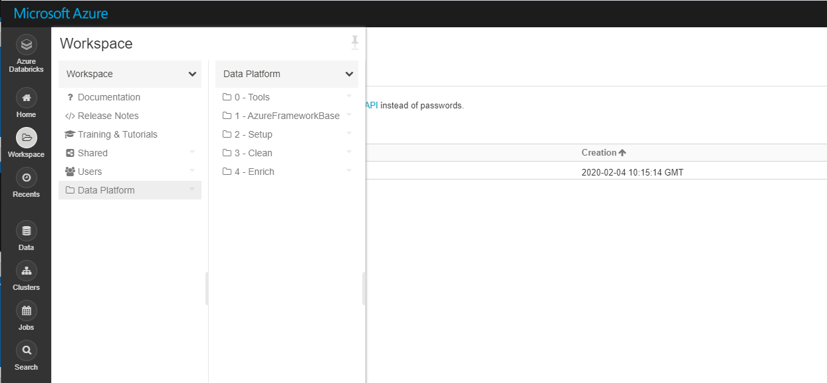
Databricks – What to deploy?
Databricks Resource
Cluster + Cluster Config
Notebooks
Permissions
Secret Scopes etc.
Remarks:
With Key Vault Scops may require manual step on the first execution
Notes:
* Semiautomatic – partially deployed automatically. Requires on the first deployment manual token generation. Pipeline will wait for PAT token to be created by release manager (RM). RM need to do KV updated and pipeline variables updated in 2 places (around 5 min work). This will be shown below

